Slide 1

THE FRAMEWORKS OF
ETHICS
September 21, 2013
www.testcracker.in
Image source: Internet [PowerPlugs – Template for PowerPoint
For the maniacs, by the maniacs…
Confidential | Copyright

Slide 2
What will you do?!
It is 5 am and you are on the way to airport. You think you may be late by 5 minutes for your flight which departs exactly at 6 am. The cab driver halts at a traffic signal which you know will take 5 minutes to turn green. Absolutely no one is there on the streets. Would you ask the driver to jump the signal to help you reach in time?
Mahatma Gandhi cancelled the Non Cooperation Movement at its peak because of the Chauri Chaura incident only because few Indians killed few British policemen. He believed in zero tolerance towards violence in his followers. But if the movement had continued, India could have achieved independence much earlier! Which school of ethics was he following in calling off the NCM?
You give a very impressive answer to a certain question in the Civil Services Interview. It was sheer luck that one of your friends had already made you prepare for this question. The interview board seems very impressed. The Chairman asks you if you had heard this question before. If you say Yes, the chances of your selection will reduce drastically. What will you say – Yes or No?

Slide 3
Why do we compromise?
There is too much to gain.
There is too much to lose.
The watchdogs are asleep.

Slide 4
What ethics IS NOT?
Ethics is NOT the same as feelings.
Ethics is NOT religion.
Ethics is NOT following the law.
Ethics is NOT following culturally accepted norms.
Ethics is NOT science.

Slide 5
“Our character is what we do when we think no one is looking.”
- Jackson Browne

Slide 6
Consider this…
You are strolling through a neighbourhood park on a free afternoon when something in the bushes nearby catches your eye. Its a woman's purse, presumably lost. Or perhaps it was stolen and then discarded. You look inside and find a drivers license. You also see a huge wad of cash. The purse wasn't stolen. What should you do?
OK…so you will return the purse, honest that you are.
Now consider this –
You have recently lost your job and are struggling to make ends meet. You are unable to pay the fees for your child’s school, and the principal has warned you today that you have just one day to pay the fees. The amount in the purse is exactly the same as the annual fees for the school.
What will you do now?
Welcome to the PROBLEM OF ETHICS….

Slide 7
The Problems of Ethics
Does ethics mean different things to different people?
Does ethics mean different things at different times to the same person?
Why should you act ‘ethically’ when there is a stronger reason to behave otherwise?
Is an excellent character something worth having and preserving even at significant costs to one's health or wealth?
Do you not feel inspired by those who make sacrifices to live up to their value systems?
Do you not feel proud of yourself when you would have successfully resisted an opportunity to act dishonestly?

Slide 8
The Is-Ought problem (David Hume)
In every system of morality, which I have hitherto met with, I have always remarked, that the author proceeds for some time in the ordinary ways of reasoning, and establishes the being of a God, or makes observations concerning human affairs; when all of a sudden I am surprised to find, that instead of the usual copulations of propositions, is, and is not, I meet with no proposition that is not connected with an ought, or an ought not. This change is imperceptible; but is however, of the last consequence.
(A Treaties of Human Nature, David Hume, 1739)
Many writers make claims about what ought to be on the basis of statements about what is. However, Hume found that there seems to be a significant difference between descriptive statements (about what is) and prescriptive or normative statements (about what ought to be), and it is not obvious how one can get from making descriptive statements to prescriptive. The is–ought problem is also known as Hume's law and Hume's Guillotine.

Slide 9
Thrasymachus’ challenge to Socrates
When Socrates praises the importance of being just and virtuous, Thrasymachus maintains that to act justly is to act for another's good and not one’s own, and the unjust person is not so foolish as to ignore his own good for the sake of another’s. The unjust person therefore gains riches and seizes opportunities that the just person forgoes, and the life of greater riches and more opportunities is surely the better life.
One familiar example in the modern world, is the military dictator who rules by terror and fraud, who loots his country’s wealth, and who lives opulently while stashing additional spoils in foreign bank accounts and other offshore havens. This type of individual, the one who practices injustice on a very large scale and succeeds, is for Thrasymachus the most happy of men. Very often we see that such men are respected for what they have achieved.
So, why be just when you can profit from being unjust?

Slide 10
What is ethics?
“A system of moral principles and a branch of philosophy which defines what is good for individuals and society.”
“Moral principles that govern a person's or group's behaviour.”
“Ethics is the philosophical study of morality. It is a study of what are good and bad ends to pursue in life and what it is right and wrong to do in the conduct of life. It is therefore, above all, a practical discipline. Its primary aim is to determine how one ought to live and what actions one ought to do in the conduct of one’s life. It thus differs from studies in anthropology, sociology, and empirical psychology that also examine human pursuits and social norms. These studies belong to positive science. Their primary aim is not to prescribe action but rather to describe, analyze, and explain certain phenomena of human life, including the goal-directed activities of individuals and groups and the regulation of social life by norms that constitute the conventional morality of a community.”

Slide 11
What is morality?
There are two accepted meanings of Morality:
One is that of morality as an existing institution of a particular society, what is commonly called the society's conventional morality.
The other is that of morality as a universal ideal grounded in reason. Its basis must consist instead of standards that derive their authority from a source that is independent of custom.
The first covers phenomena studied in anthropology and sociology.
The second defines the subject of ethics.

Slide 12
Normative Ethics
Teleological
Theory
Deontological
Theory
Ethical
Egoism
Utilitarian
Principle
Altruism
Kantianism
Moral
Absolutism

Slide 13
Teleological theories
Teleos means ‘end’. These theories are concerned with the consequences of the action.
Ethical egoism contrasts with ethical altruism, which holds that moral agents have an obligation to help others.
Egoism and altruism both contrast with ethical utilitarianism, which holds that a moral agent should treat one's self with no higher regard than one has for others (as egoism does, by elevating self-interests and "the self" to a status not granted to others), but that one also should not (as altruism does) sacrifice one's own interests to help others' interests, so long as one's own interests (i.e. one's own desires or well-being) are substantially equivalent to the others' interests and well-being.
Egoism, utilitarianism, and altruism are all forms of consequentialism, but egoism and altruism contrast with utilitarianism, in that egoism and altruism are both agent-focused forms of consequentialism (i.e. subject-focused or subjective), but utilitarianism is called agent-neutral (i.e. objective and impartial) as it does not treat the subject's (i.e. the self's, i.e. the moral "agent's") own interests as being more or less important than the interests, desires, or well-being of others.

Slide 14
Deontological theories
Derived from greek word ‘deon’ which means duty. This approach believes we have a duty not to do bad
Kant argued that it was not the consequences of actions that make them right or wrong but the motives of the person who carries out the action.
To act in the morally right way one must act purely from duty begins with an argument that the highest good must be both good in itself and good without qualification
He concludes that there is only one thing that is truly good:
“Nothing in the world—indeed nothing even beyond the world—can possibly be conceived which could be called good without qualification except a good will”
Moral Absolutism - Certain actions are absolutely right or wrong, regardless of the intentions behind them as well as the consequences
Divine Command Theory - An action is right if God has decreed that it is right☺

Slide 15
The Approaches to Ethical Conduct
The Utilitarian Approach
The Rights Approach
The Fairness (Justice) Approach
The Common Good Approach
The Virtue Approach

Slide 16
The Utilitarian Approach
Focuses on the consequences that actions or policies have on the well-being of all persons directly or indirectly affected by the action or policy.
The principle states: "Of any two actions, the most ethical one will produce the greatest balance of benefits over harms."
Utilitarianism was conceived in the 19th century by Jeremy Bentham and John Stuart Mill to help legislators determine which laws were morally best.
To analyze an issue using the utilitarian approach, we first identify the various courses of action available to us. Second, we ask who will be affected by each action and what benefits or harms will be derived from each. And third, we choose the action that will produce the greatest benefits and the least harm.
The ethical action is the one that provides the greatest good for the greatest number.

Slide 17
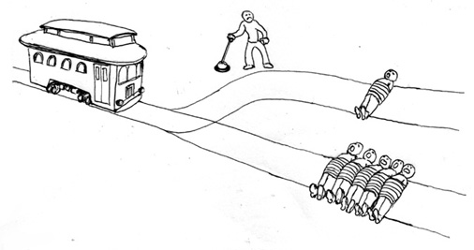
The Trolley Problem
Situation I: Suppose that a trolley is running down a hill at a fast speed, heading towards five people at the bottom of the street. When it reaches them it will surely kill all of them. You notice that there is a switch next to you that could direct the trolley to a side path where there is one man standing and once you do, it will be the one man that dies. What will you do and why?

Slide 18
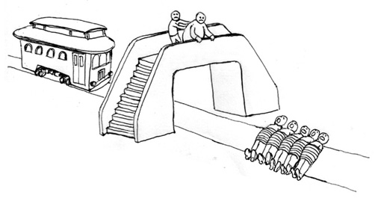
The Trolley Problem - II
Situation II: Suppose that a trolley is running down a hill at a fast speed, heading towards five people at the bottom of the street. When it reaches them it will surely kill all of them. You notice that there is a fat man on just next to you. If you push the fat man on the track, his body is large enough to stop the trolley in its tracks. But the fat man will surely die. Will you kill the fat man to save the five men?

Slide 19
The Trolley Problem (Utilitarian Solution)
There is NO ONE SOLUTION to this problem
Those who subscribe to the philosophical theory of utilitarianism would say that both are justified. Utilitarianism is a no-frills view of consequences. If the outcome for five people is good and the outcome is bad for one, the action is justified, permissible and even obligatory!
Most people say they will pull the lever in the first case but won’t push the fat man on the tracks in the second case, although the outcome is the same – saving 5 lives, letting go of 1!

Slide 20
The Doctrine of Double Effect (Thomas Aquinas)
This doctrine says that for an act to be morally permissible, it has to fit certain criteria.
First, the outcome has to be a good one. Both examples in the trolley problem have that -- five people survive a terrible accident.
Secondly, the outcome has to be at least as important as the action taken. Both examples cover that, too -- five lives outweigh one.
Thirdly, the action can't be taken for the purposes of evil, even if it does result in beneficial good. In other words, you can't pull the lever just because you want to kill the man standing in front of the sand pit.
Lastly, the good effect has to be produced by the action taken, not by the bad effect. And here we reach the reason why pulling the switch is preferable to pushing the man onto the tracks.
By pulling the lever, we are taking an action that indirectly results in the death of the man on the track. In the second example, we are intentionally pushing the man to his death. Although five people's lives will still be saved, according to Aquinas (and to many philosophers), an evil act never justifies a greater good.

Slide 21
The Rights Approach
Ethical action is the one that best protects and respects the moral rights of those affected.
Each person has a fundamental right to be respected and treated as a free and equal rational person capable of making his or her own decisions.
It has its roots in the philosophy of the 18th-century thinker Immanuel Kant who focused on the individual's right to choose for herself or himself. According to him, what makes human beings different from mere things is that people have dignity based on their ability to choose freely what they will do with their lives, and they have a fundamental moral right to have these choices respected. People are not objects to be manipulated; it is a violation of human dignity to use people in ways they do not freely choose.

Slide 22
The Rights Approach
The right to the truth
We have a right to be told the truth and to be informed about matters that significantly affect our choices.
The right of privacy
We have the right to do, believe, and say whatever we choose in our personal lives so long as we do not violate the rights of others.
The right not to be injured
We have the right not to be harmed or injured unless we freely and knowingly do something to deserve punishment or we freely and knowingly choose to risk such injuries.
The right to what is agreed
We have a right to what has been promised by those with whom we have freely entered into a contract or agreement.

Slide 23
The Fairness/Justice Approach
Focuses on how fairly or unfairly our actions distribute benefits and burdens among the members of a group.
Fairness requires consistency in the way people are treated.
The principle states: "Treat people the same unless there are morally relevant differences between them."
It has its roots in the teachings of the ancient Greek philosopher Aristotle, who said that "equals should be treated equally and unequals unequally."
Favoritism gives benefits to some people without a justifiable reason for singling them out; discrimination imposes burdens on people who are no different from those on whom burdens are not imposed. Both favoritism and discrimination are unjust and wrong.
What about giving food subsidies to the poor people?

Slide 24
The Common Good Approach
Presents a vision of society as a community whose members are joined in a shared pursuit of values and goals they hold in common.
The community is comprised of individuals whose own good is inextricably bound to the good of the whole.
The principle states: "What is ethical is what advances the common good."
The common good is a notion that originated more than 2,000 years ago in the writings of Plato, Aristotle, and Cicero. More recently, contemporary ethicist John Rawls defined the common good as "certain general conditions that are...equally to everyone's advantage."
We focus on ensuring that the social policies, social systems, institutions, and environments on which we depend are beneficial to all. Examples of goods common to all include affordable health care, effective public safety, peace among nations, a just legal system, and an unpolluted environment.

Slide 25
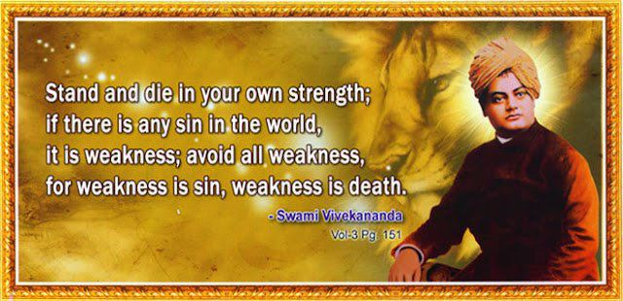

Slide 26
The Virtue Approach
Focuses on attitudes, dispositions, or character traits that enable us to be and to act in ways that develop our human potential. These ideals are discovered through thoughtful reflection on what kind of people we have the potential to become.
Examples: honesty, courage, faithfulness, trustworthiness, integrity, self-control, etc.
The principle states: "What is ethical is what develops moral virtues in ourselves and our communities."
Virtues are like habits; that is, once acquired, they become characteristic of a person. Moreover, a person who has developed virtues will be naturally disposed to act in ways consistent with moral principles. The virtuous person is the ethical person.
In dealing with an ethical problem using the virtue approach, we might ask, What kind of person should I be?

Slide 27
Problems With These Approaches
We may not agree on the same set of human and civil rights, what constitutes the common good, what is good and what is harmful.
The different approaches may not answer the question “What is ethical?” in the same way.

Slide 28
How to Resolve Ethical Issues?

Slide 29
Step I: Get the Facts
What are the relevant facts of the case? What facts are unknown?
What individuals and groups have an important stake in the outcome? Do some have a greater stake because they have a special need or because we have special obligations to them?
What are the options for acting? Have all the relevant persons and groups been consulted? If you showed your list of options to someone you respect, what would that person say?

Slide 30
Step II: Evaluate Alternative Responses
Utilitarian Approach: The ethical action is the one that will produce the greatest balance of benefits over harms. Which option will produce the most good and do the least harm?
Rights Approach: The ethical action is the one that most dutifully respects the rights of all affected. Even if not everyone gets all they want, will everyone's rights and dignity still be respected?
Fairness or Justice Approach: The ethical action is the one that treats people equally, or if unequally, that treats people proportionately and fairly. Which option is fair to all stakeholders?
Common Good Approach: The ethical action is the one that contributes most to the achievement of a quality common life together. Which option would help all participate more fully in the life we share as a family, community, society?
Virtue Approach: The ethical action is the one that embodies the habits and values of humans at their best. Would you want to become the sort of person who acts this way (e.g., a person of courage or compassion)?

Slide 31
Step III: Decide!
Considering all these perspectives, which of the options is the right or best thing to do?
If you told someone you respect why you chose this option, what would that person say?
Implement…

Slide 32
To be continued…
Email your doubts to: support@testcracker.in

